Slide 1
Risk Assessment for Pushing and Pulling
RAPP Tool
Andrew Pye – STILL Materials Handling UK 2018

Slide 2
Structure of the tool
There are two types of pushing and pulling operations you can assess using the HSE designed RAPP Tool:
moving loads on wheeled equipment, such as hand trolleys, pump trucks, carts or wheelbarrows.
moving loads without wheels, which might involve actions such as dragging/ sliding, churning (pivoting and rolling) and rolling.
This assessment focuses on moving loads on wheeled equipment, such as hand trolleys, pump trucks, carts or wheelbarrows and should be used to assist customers with their Manual Handling Risks carrying out this operation.
For Moving loads without wheels, the customer can follow the guidance and RAPP tool provided by the HSE.
Use of the tool may not comprise a full risk assessment.
HSE’s guidance booklet L23 Manual handling. Manual Handling Operations Regulations 1992: Guidance on Regulations3 contains more information on conducting full risk assessments. Always consider individual and psychosocial issues when completing the RAPP score sheet.

Slide 3
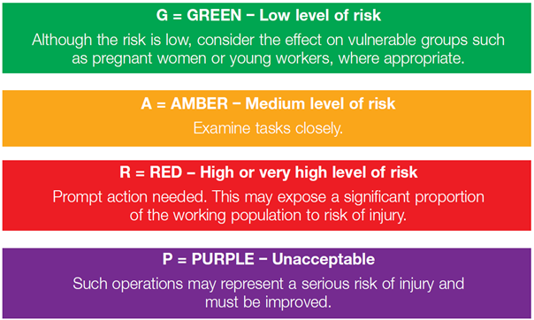
How to complete an assessment
Spend some time observing the workers and the work activity to ensure that what you are seeing is representative of normal working practice. Always consider the ‘worst-case scenario’.
Consult employees and safety representatives during the assessment process.
Where several people do the same activity, make sure you get the views of workers about the demands of the operation.
Ensure you read this assessment guide in full before you make your assessment.
Follow the appropriate flow chart and assessment guide to determine the level of risk for each risk factor. The levels of risk are:

Slide 4
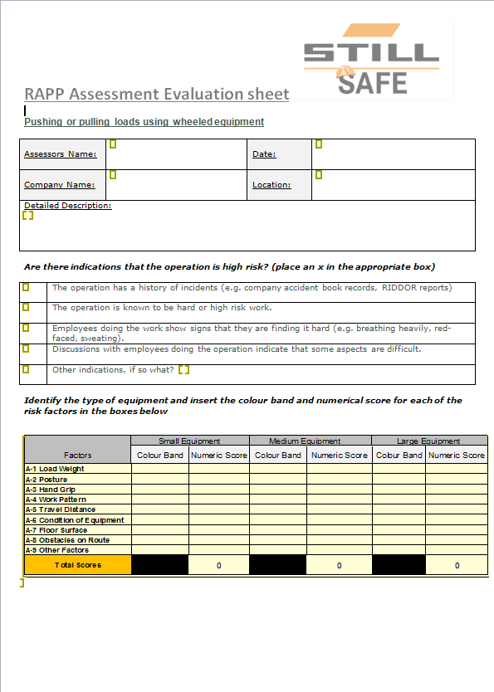
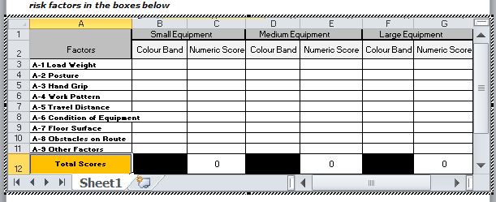
How to complete an assessment
Open the RAPP Assessment Evaluation Sheet.
Complete the required fields by typing into the boxes provided.
Double click within the evaluation section to open up the working areas.

Slide 5
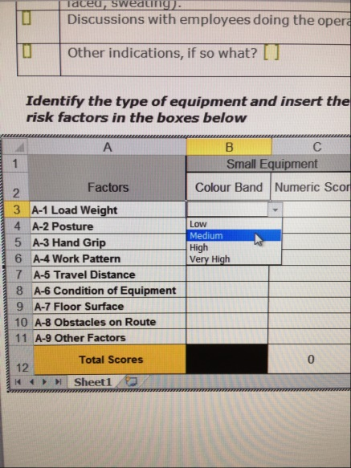
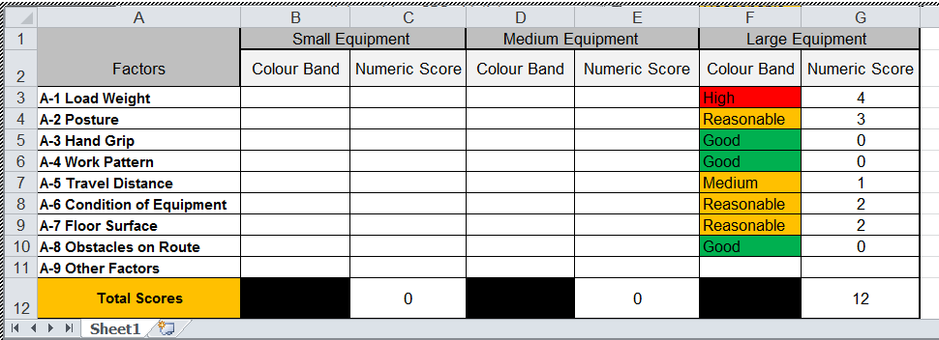
How to complete an assessment
Enter the colour band and corresponding numerical score in the appropriate column of the score sheet following the guidance set out in slides 6 onwards of this presentation. Enter the remaining task information asked for on the score sheet.
Add up the scores to obtain the total score for the operation. The total scores help prioritise those activities/operations that need most urgent attention and help check the effectiveness of any risk-reduction measures. The colour bands help determine which risk factors of the operation require attention.
The scores can be used for comparison purposes but the total scores do not relate to specific action levels.
Where tasks require attention, first look for solutions where it is reasonably practicable to eliminate the hazard, for example through redesign of the work or automation of the task. Where these measures are not practicable, identify how tasks might be improved to avoid or reduce those factors that score red. Then consider how to reduce the amber scores.

Slide 6
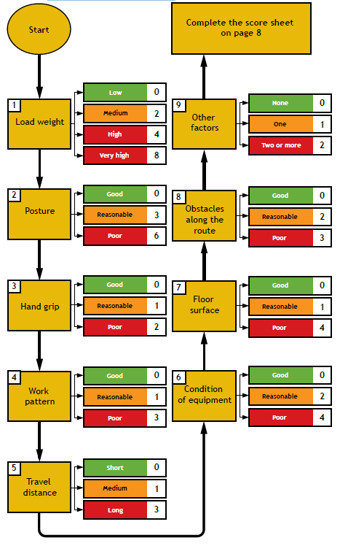

Risk Levels and Scores of Pushing or pulling loads on wheeled equipment
Evaluate Assessment to Eliminate/ Reduce the Risk as Far as Reasonably Practicable

Slide 7
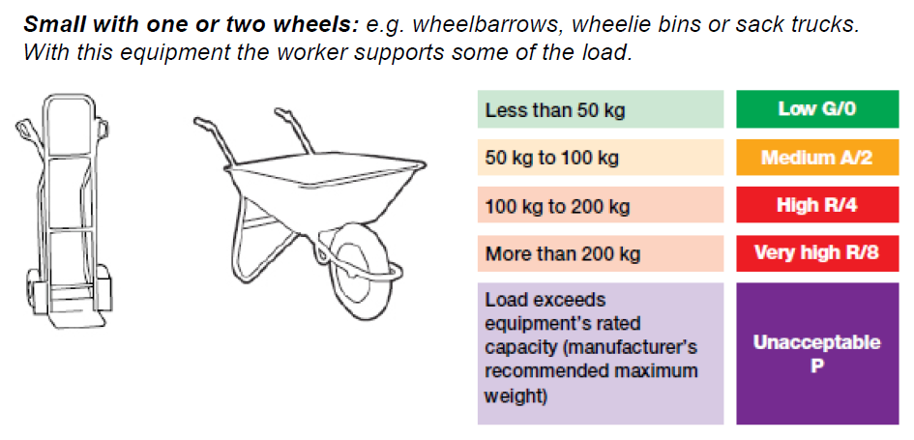
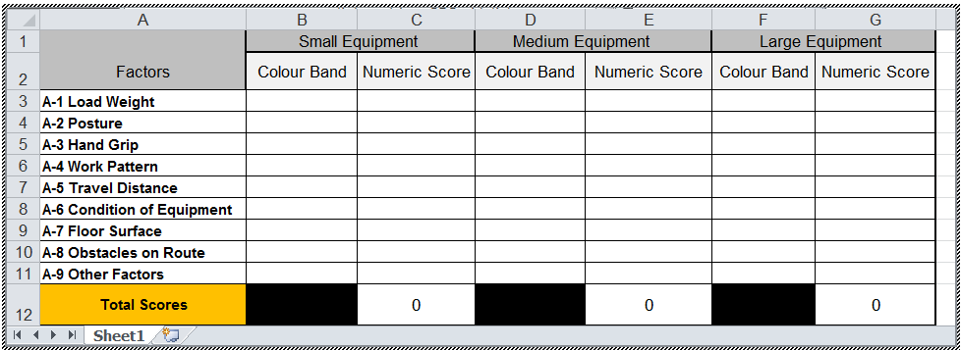
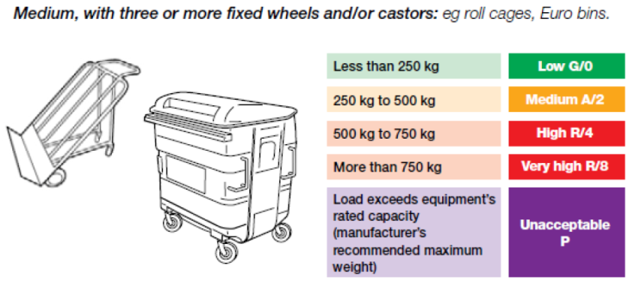
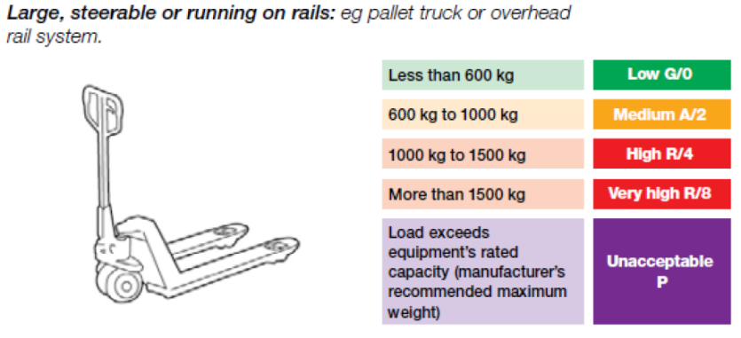
Assessment guide
Question:- A-1 Type of equipment/Load weight (kg)
Identify the type of equipment used – small, medium or large. If different types of equipment are used to move loads, do an assessment for each type.
If more than one piece of loaded equipment is moved at a time (eg two trolleys), assess the total load moved.
Find out the total load moved (weight of the equipment and weight of loads carried) from labelling, by asking the workers or by weighing.
If the same equipment is used to move different loads, then assess the equipment with the heaviest load that is likely to be moved.
The illustrations in each section are only a guide to help you – they are not comprehensive.

Slide 8
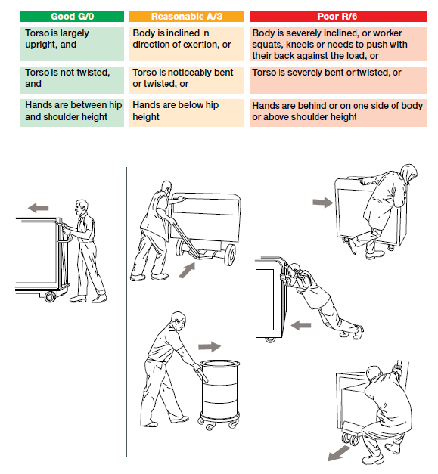
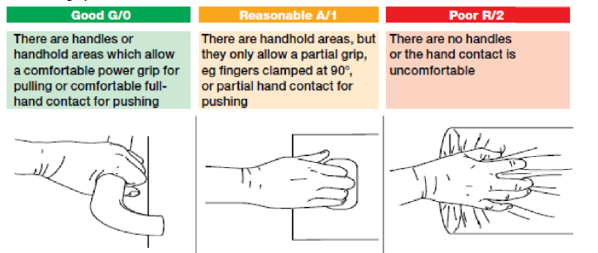
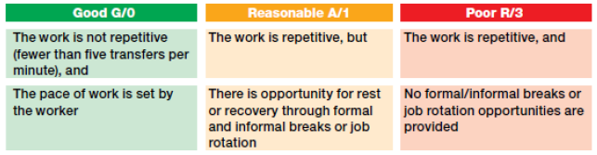
Assessment guide
Question:- A-3 Hand grip
Observe how the hand(s) grip or contact the equipment during pushing or pulling. If the operation involves both pushing and pulling, assess the hand grip for both actions.
Question:- A-2 Posture
Observe the general positions of the hands and the body during the operation.
Question:- A-4 Work pattern
Observe the work, noting whether the operation is repetitive (five or more transfers per minute) and whether the worker sets the pace of work. Ask workers about their pattern of breaks and other opportunities to rest or recover from the work.

Slide 9
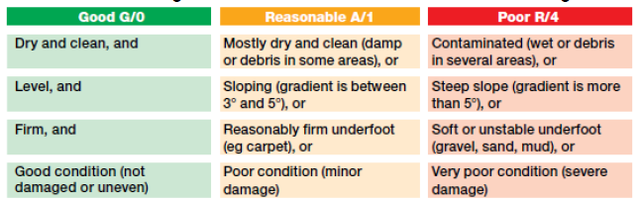
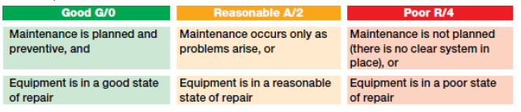

Assessment guide
Question:- A-5 Travel distance
Determine the distance from start to finish for a single trip.
If the operation is not repetitive, do an assessment for the longest trip.
If the operation is repetitive, determine the average distance for at least five trips.
Question:- A-7 Floor surface
Identify the condition of the surfaces along the route and determine the level of risk using the following criteria.
Question:- A-6 Condition of equipment
Enquire about the maintenance programme and observe the general state of repair of the equipment (condition of the wheels, bearings and brakes).
Question:- A-8 Obstacles along the route
Check the route for obstacles. Note if the equipment is moved over trailing cables, across raised edges, up or down steep ramps (gradient of more than 5°), up or down steps, through closed/narrow doors, screens or confined spaces, around
bends and corners or objects. Each type of obstacle should only be counted once no matter how many times it occurs.

Slide 10
Assessment guide
Question:- A-9 Other factors
Identify any other factors, for example:
the equipment or load is unstable;
the load is large and obstructs the worker’s view of where they are moving;
the equipment or load is sharp, hot or otherwise potentially damaging to touch;
there are poor lighting conditions;
there are extreme hot or cold temperatures or high humidity;
there are gusts of wind or other strong air movements;
personal protective equipment or clothing makes using the equipment more difficult.

Slide 11

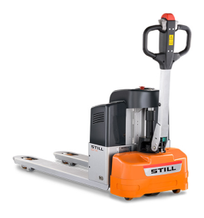
Conclusion:-
Review of Evaluation Sheet:-
Once the RAPP Assessment Evaluation sheet is complete, an assessment of the risks should be made following the HSE Hierarchy of Control:-
Elimination of the Task/ Risk
Substitution of the Task/ Equipment
Engineering Controls
Safe Systems of Work
Personal Protective Equipment.
The Possible Solution
The Risk
STILL ECU 15
Musculoskeletal Injuries
Prosecution
Sick Pay
Claims
Investigation Time
Replacement Staff
Injuries
Loss of production
Increased Insurance Premiums
Legal Representation following Claims
“By using a STILL Powered Pallet Truck you will eliminate the Risk of Pushing and Pulling”

Slide 12
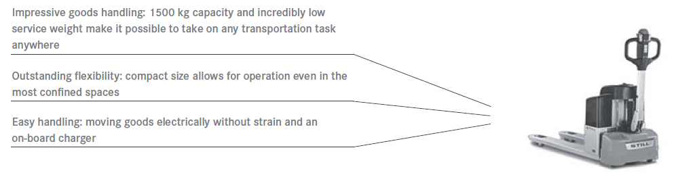
The Spec:-

Slide 13
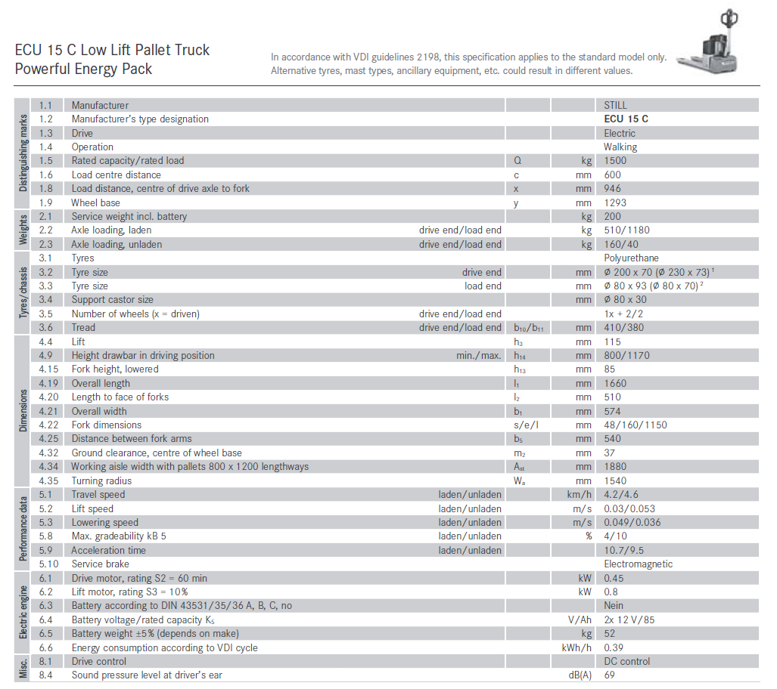
The Spec:-

